Slide 1
Quiz Time
Would I lie to you?
Prize(s) for the most correct answers!

Slide 2
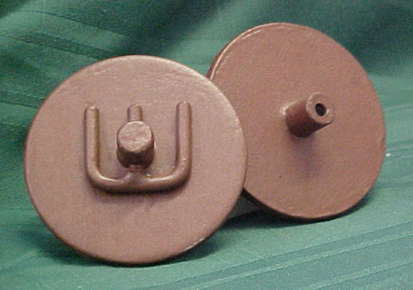
What are these objects?
Read the three explanations then decide…

Slide 3
Are these objects…
1
Parts of an Iron Age war chariot’s harness?
2
Ancient Greek voting ballots?
3
Pulley wheels from one of Titanic’s lifeboat davits?

Slide 4
Vote now!

Slide 5
Answer
2
They are Greek voting ballots
In Greek courts each juror (only men) was issued with two slightly different bronze tokens which were used for giving their verdict at the end of the trial. They were small enough to be concealed in the hand so other people in the court could not see which token was given in to record their verdict.

Slide 6
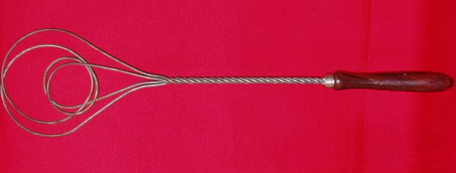
What is this object?
Listen to the three explanations then decide…
2

Slide 7
Is this object…
A 1930s carpet beater?
1
An elaborate bubble blower used by a 1930s street entertainer?
2
3
A 1930s implement for holding bread over an open fire to toast it?

Slide 8
Vote now!

Slide 9
Answer
1
It is a 1930s carpet beater
An inscription on the chrome ring at the top of the handle gives the maker’s name, Kleen-eze, and the patent date as 1928.
However it also works as a bubble blower and to toast bread – we tried!

Slide 10
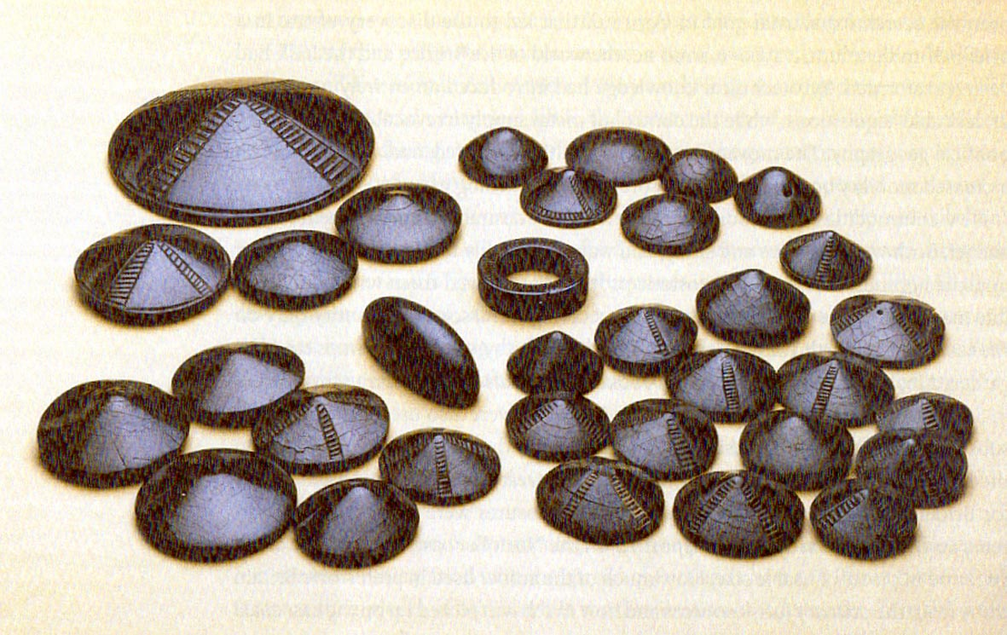
Are these objects …
1
Victorian?
2
Egyptian?
3
Bronze Age?

Slide 11
Vote now!

Slide 12
Answer
3
They are Bronze Age jet buttons and a pulley ring
They were found at Harehope in Peebleshire, Scotland. Jet essentially only comes from Whitby in Yorkshire. So the beads illustrate not just the fine workmanship that was being achieved during the Bronze Age in Britain, but also that long distance travel and trade was taking place and that Bronze Age people desired beautiful and rare objects.

Slide 13
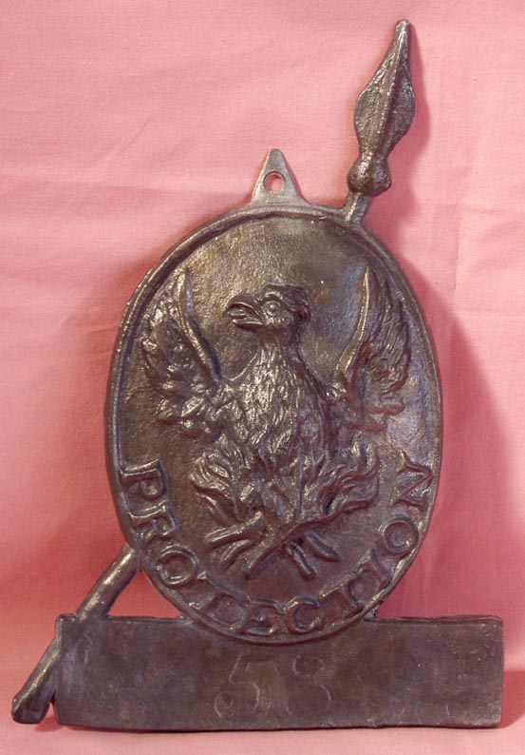
What is this artefact?
Maker’s mark from Titanic’s lifeboats
1
A WW1 regimental badge
3
2
A firemark used after the Great Fire of London

Slide 14
Vote now!

Slide 15
Answer
2
It is a firemark
After the Great Fire of London, insurance schemes for fire protection developed. Plaques like this were fixed in prominent positions on the front of buildings to show that they had insurance.
However, if fire engines from different companies arrived at the scene to the fire, they would just leave and let the building burn!

Slide 16
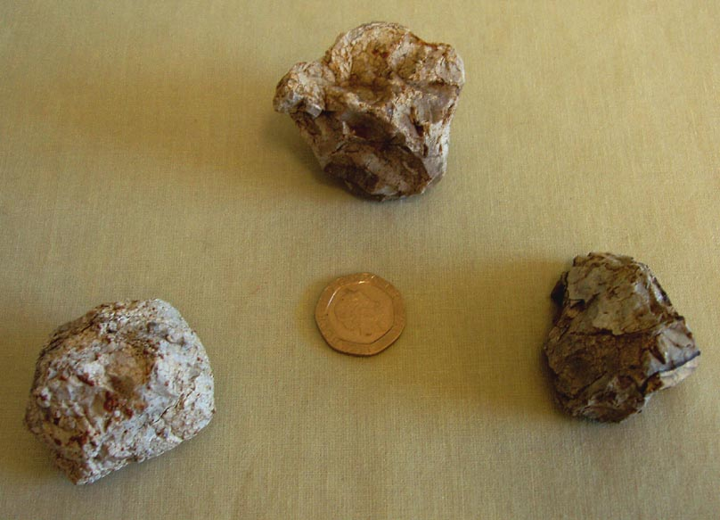
Are these objects…
Iron Age gaming pieces?
1
2
3
Anglo-Saxon counting aids?
Neolithic pot boilers?

Slide 17
Vote now!

Slide 18
3
Answer
They are Neolithic pot boilers
These flint stones were used in Neolithic times to heat water. The stones were heated in a fire then dropped into the cooking water. Their cracked surface comes from the repeated heating and cooling. Although pottery was in use it would crack if placed on a fire to heat.
They were found in Wiltshire.

Slide 19
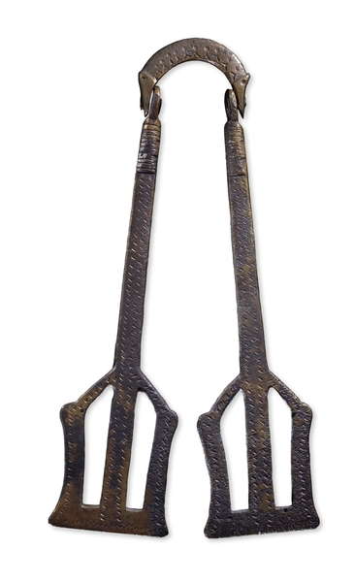
What is this object?
1
Medieval cooking tongs for lifting and turning food.
2
Anglo-Saxon Girdle-hanger, 6th century AD
Worn hanging from around the waist to show that a woman was in charge of the house.
3
1930s street trader’s clappers Used to attract customers.

Slide 20
Vote now!

Slide 21
Answer
2
Girdle-hanger
From: Searby, Lincolnshire Date: 6th century AD
Strange-looking objects like these are mainly found in the graves of well-off Anglo-Saxon women. They were probably worn hanging from the woman's belt, or girdle, to show that she was in charge of the house. It was a woman's job to supervise servants and ensure the smooth-running of her household.
This girdle-hanger is decorated at the top with two bird or animal heads with beady eyes. The long paddle-like 'keys' on each side probably show that she had the keys to the house.

