Slide 1
Building our curriculum map

Slide 2
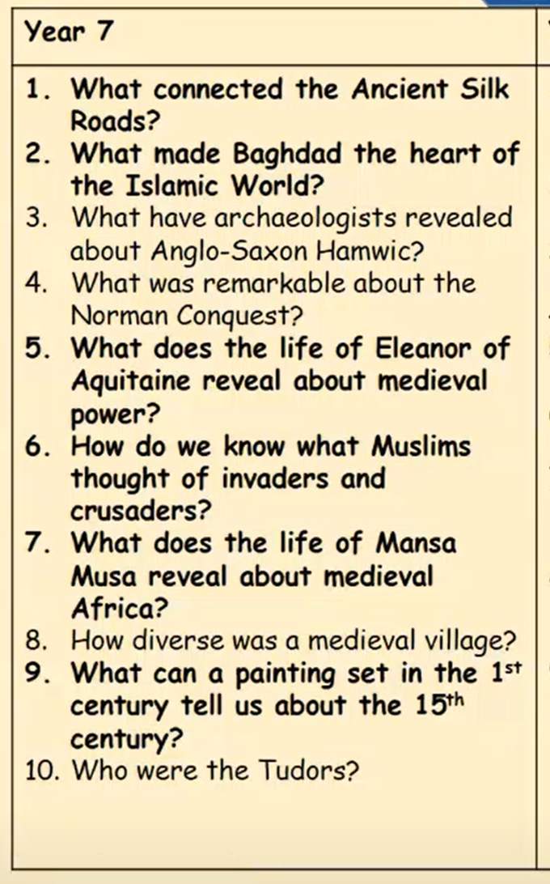

Slide 3
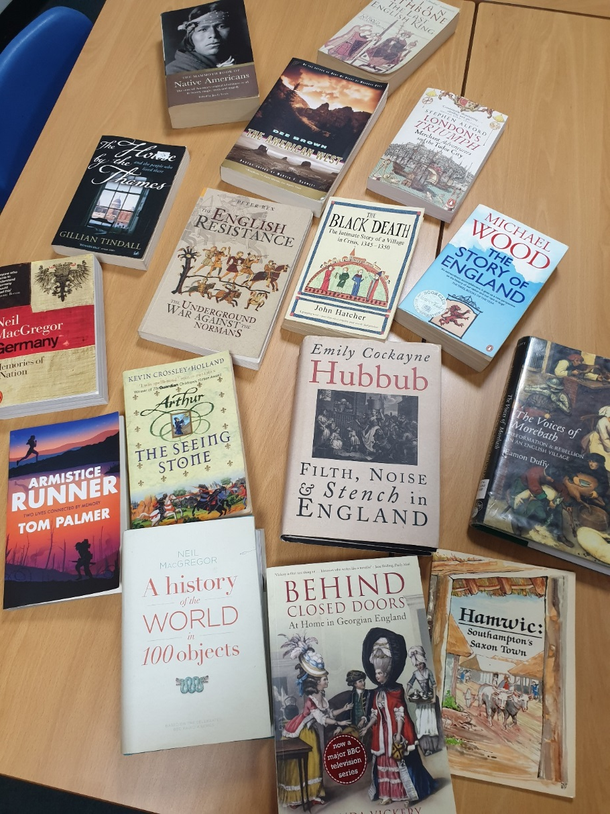
How did we PLAN for the curriculum to deliver this?
What do we want pupils to know and understand about each period?

Slide 6
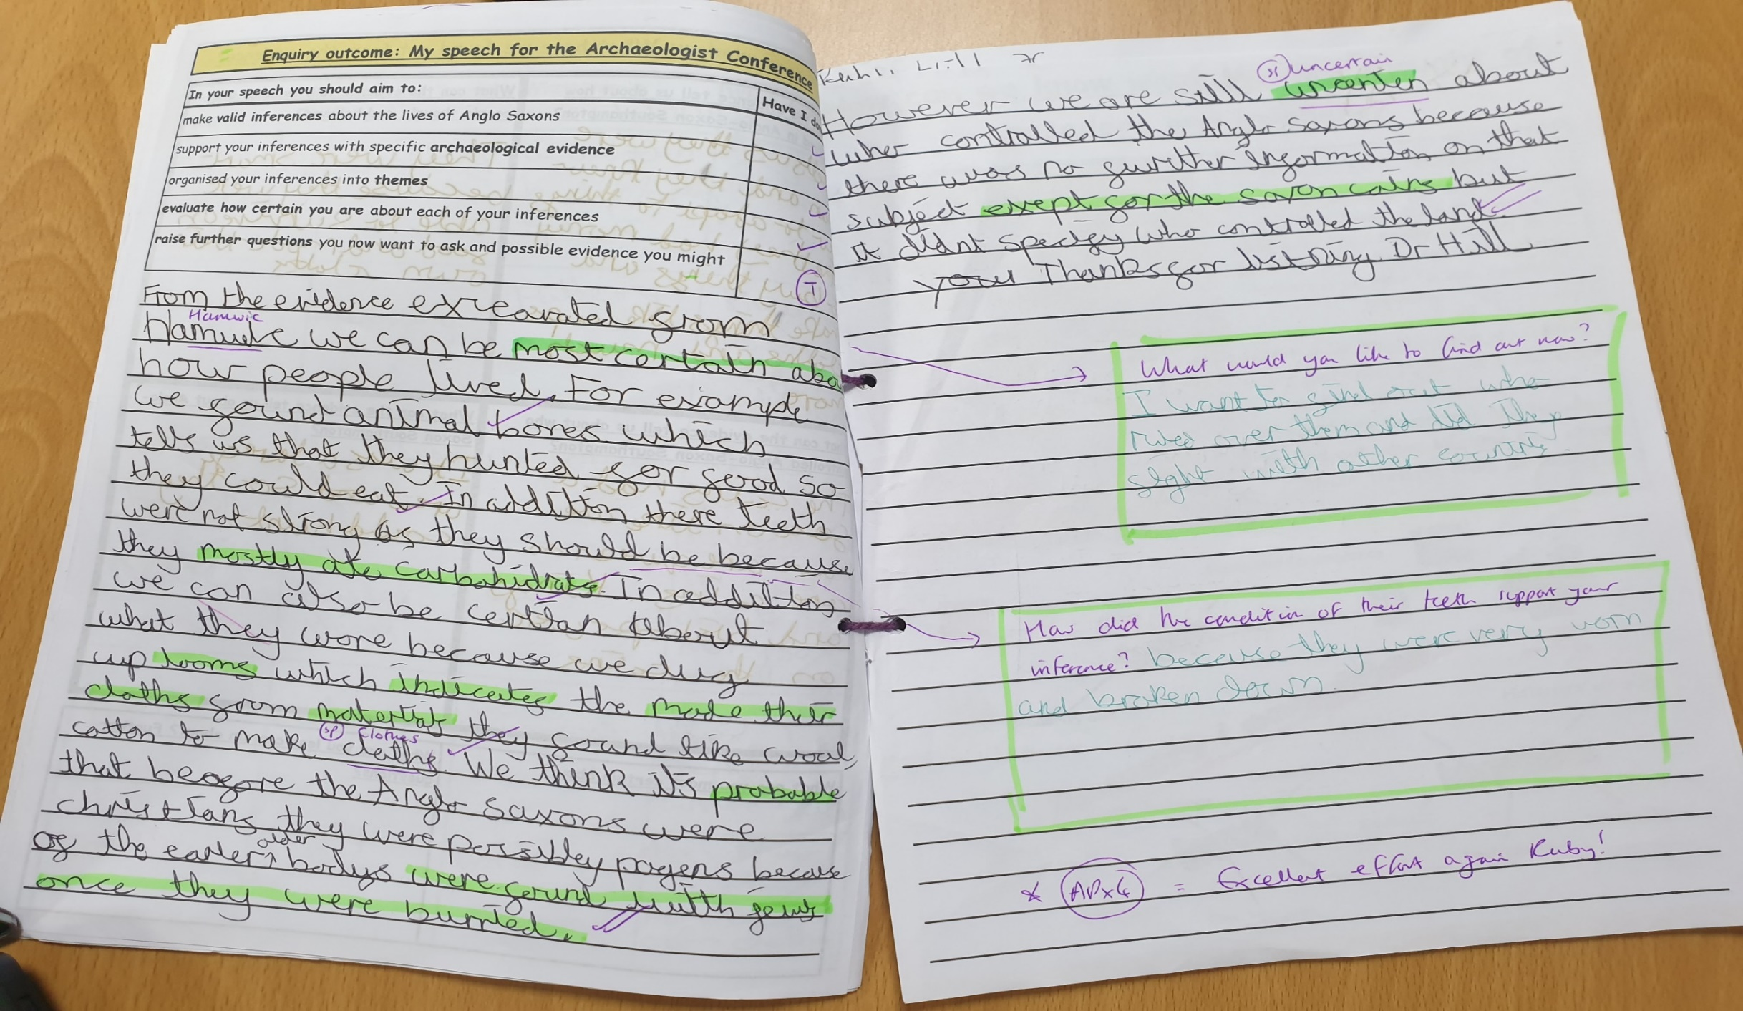
What have archaeologists revealed about Anglo Saxon Southampton?

