Slide 1
This lesson is by Alicia Binding from Calthorpe Park School based on The British Legion downloadable resources:

Slide 2
What do you know about VE Day?

Slide 3
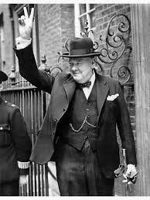
VE DAY
On 7th May 1945, Winston Churchill made an announcement on the radio that Germany had officially surrendered. He declared that the next day (8th May) would become Victory in Europe day and a national holiday for everyone.
In his announcement, Churchill paid tribute to Britain’s allies: “Finally almost the whole world was combined against the evil-doers, who are now prostrate before us. Our gratitude to our splendid Allies goes forth from all our hearts in this Island and throughout the British Empire.” A total of 46 countries fought together in the war.
Even though VE Day marked victory for Europe over Germany, World War Two was still not over. Even after 8 May, many soldiers, sailors and pilots were sent to the east to fight in Japan.

Slide 4
VE DAY
VE Day was a huge moment for people across Europe as it marked the end of many years of conflict. It was a moment of great relief and hope for the future – and a day for communities to come together for a period of celebration.
Students might notice that there are predominantly women and children in this photo as lots of men were soldiers and wouldn’t have started their journey home from the front lines yet.

Slide 5
British Commonwealth
This military parade in Kenya, one of Britain’s allies during the war, recognised the bravery of the soldiers who fought in the war to protect our freedoms and welcomed them home. With nearly 18 million service personnel killed on the battlefields in Europe, not everyone was able to return home.
In addition to the celebrations, VE day was a time of thanksgiving – to show gratitude to all those who served and sacrificed in the war effort such as:
Service personnel including Commonwealth forces and Britain’s allies
Those who served on the Home Front, for example as Land Girls, Home Guard, Women’s Timber Corps, and the like, either as civilians in reserved occupations or with the Armed Forces
Men and women who served in the emergency services
Civillians who took in and looked after evacuees

Slide 7
How do you think people felt
hearing those words?
Was the war over for everyone?

Slide 8
Why Should we Remember VE DAY?
This year it is the 75th anniversary of VE Day. To commemorate the event, the early May bank holiday (usually a Monday) has been moved so that the bank holiday is the same day as VE Day – Friday 8th May.
Due to these unprecedented times, there will be no special events taking place this Friday or across the weekend. However we can still give thanks to those who served in the war and to remember all those who lost their lives.

Slide 9
Veterans Remember VE Day
5 Years ago marked the 70th anniversary of VE Day, when World War Two in Europe came to an end. News of peace was greeted with street parties and celebration.
BBC News spoke to three people who remember the fighting and the declaration of peace.
Ken Wilkinson is now 96. He served with No 19 Squadron throughout WWII as a Spitfire pilot.
Harold Bradley, 91, joined the army as soon as he turned 18. He trained as a signaller and was with 131st Field Regiment Royal Artillery by the time the war ended.
Esme Woodman was 20 when war broke out. She joined the Fire Brigade, moving up the ranks to Water Officer. She is now 94.
Watch this video link
https://www.bbc.co.uk/news/av/uk-32626521/veterans-remember-ve-day

Slide 10
How do you think returning soldiers felt about coming home?

Slide 13
The Cost of the War
Victory in Europe had been costly. Between 50 – 60 million people died in WW2. Out of those deaths, 45 million were civilians (people not serving in the armed forces).
It is estimated that nearly 18 million service personnel were killed on the battlefields in Europe, including 11 million Allies.

Slide 18
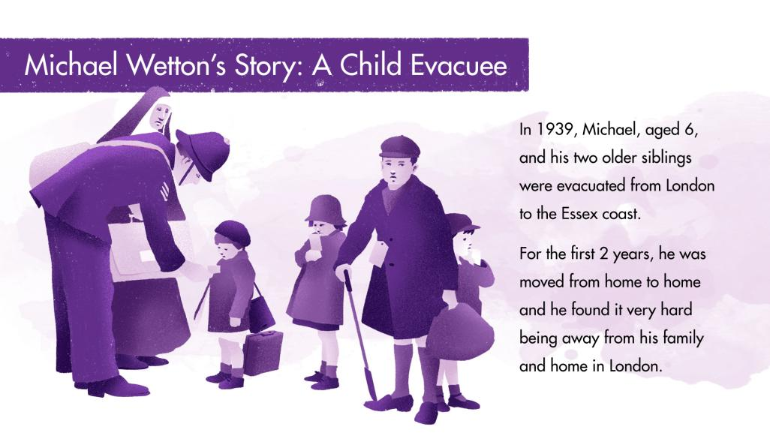

Slide 20
Evacuees
Michael was one of many children who were evacuated from London during the war. Evacuees were sent to live with other families in safe areas of the country whilst London was being bombed. Michael and his two older siblings left their home and their parents in 1939, and were sent to live near the Essex coast.
In 1944, many evacuees started to return home. However, in August 1944, Michael’s family home was hit by a Doodlebug (V1 rocket) and so his mother did not feel it was safe for them to come back. Then in January 1945, their house was hit again – this time it suffered a lot of damage. The front door was blown off and the water tank burst, flooding the house. Michael’s mother was at home but miraculously survived. She was recued and taken to hospital before going to her parents house. Unfortunately, there was not enough room in Michael’s grandparent’s house for the whole family, so Michael and his siblings could not yet return home. The war was over, and Michael was now 12 years old. He had been away from his family for 6 years, and yet still could not return.
Michael's experience stayed with him forever, and throughout adulthood he dedicated himself to helping others. In 1953, he trained to be a teacher – and was for 30 years. He also supported charities like Save the Children and Shelter, which focus on helping children and the homeless.

Slide 22
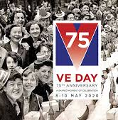
VE DAY TASK
Your task is to write a letter to your History teaching explaining why it is important to remember VE Day.
Things you may want to consider:
The significance of the ending of the war: VE Day was as much about celebrating the war as it was celebrating the victory over the Nazis.
The Human Cost of war and the sacrifices made by so many: Victory in Europe had been costly. Between 50 – 60 million people died in WW2. Out of those deaths, 45 million were civilians (people not serving in the armed forces). It is estimated that nearly 18 million service personnel were killed on the battlefields in Europe, including 11 million Allies.
Remembering the Impact on People’s Lives: There were approximately 40 million refugees scattered across Europe. By the end of the Second World War around 3.5 million people, mainly children had experienced evacuation so to protect their lives.

