Slide 1
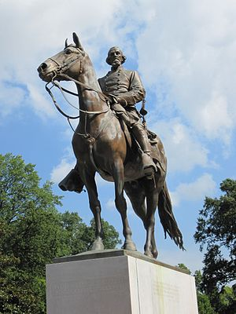
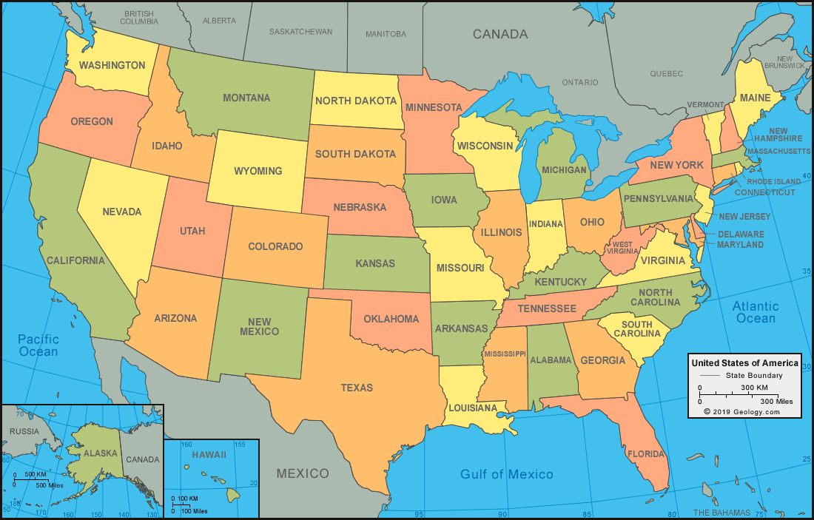
Confederate State Enquiry by Stuart Farley at Upper Shirley High School
Who does the Nathan Bedford Forrest Monument really tell us about?
Your enquiry
This 20 foot bronze statue of Nathan Bedford Forrest stood in Forrest Park, Memphis, Tennessee from 1905 to 2017.
Surely, the statue tells us about the man in the statue - Nathan Bedford Forrest. He must have been a great man who did great things to be adored by the people of Memphis in this way in 1905. In reality, the story behind the statue is much more complicated and uncomfortable, communicating a narrative which caused division and suffering across the US at the start of the 20th century and is still being challenged by the Black Lives Matter protests in the US and Britain today.
In this enquiry you are going to find out who Nathan Bedford Forrest really was, why the white elite in Memphis honoured him with a statue in 1905 and how the story behind the narrative has been challenged since the second half of the twentieth century and rewritten today.
How has the sculptor made Nathan Bedford Forrest appear noble and heroic?

Slide 2
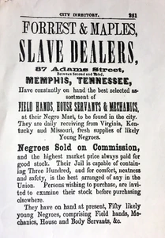
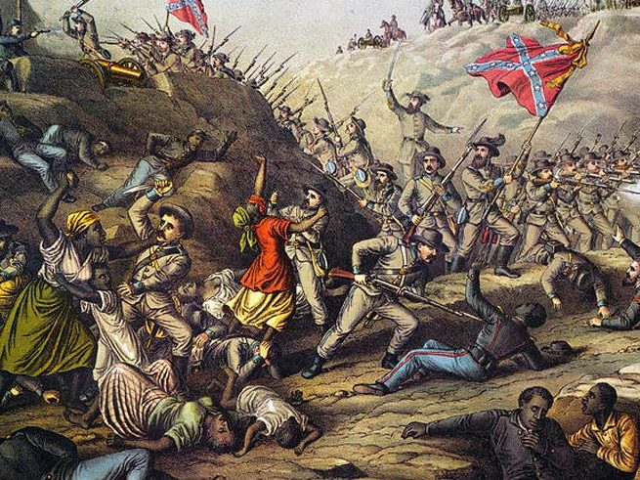
Nathan Bedford Forrest
Nathan Bedford Forrest had been born into poverty in rural Tennessee in 1821, and after establishing himself as a successful cotton planter in Mississippi, he moved to Memphis and eventually became one of the largest slave traders on the Mississippi river. With its direct river route into the slave markets of the deep South, Memphis was perfectly situated for the trading of slaves, and by the 185s Forrest claimed to be worth over a million dollars. The slave trade, with its massive wealth and business connections, also gave Forrest a great deal of influence in Memphis, where he was elected a town alderman in 1858.
When Tennessee succeeded in June 1861 to join the Confederacy, Forrest enlisted in the Confederate Army and was soon commissioned to raise his own cavalry regiment. Although he lacked any military education, Forrest proved a remarkable commander, and in 1864 the general led his troops in two battles that would later have a profound effect on his image. In April of that year Forrest and his men overwhelmed a much smaller Union army positioned on the Mississippi River a Fort Pillow, Tennessee, and in the process they were held responsible for one of the worst atrocities of the war. Confederate troops attacked a garrison that included several units of the U.S. Coloured Troops, some of whom were rumoured to have been former slaves of Forrest’s. Within minutes over half of the Federal force had been killed or wounded, and a disproportionate 66% of the black troops lay dead. Confederate losses were minimal. Soon, thereafter a congressional committee deemed the affair “an indiscriminate slaughter”, and African Americans and many northerners came to know Forrest as the “Butcher of Fort Pillow”.

Slide 3
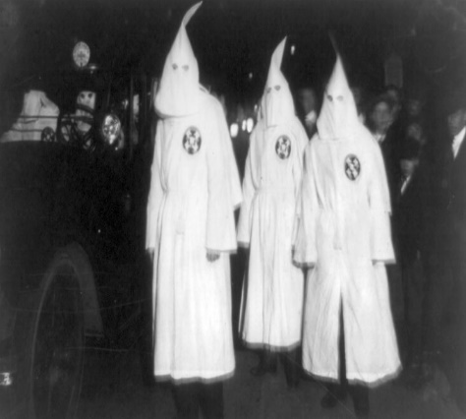
Two months later Forrest led a rout of a much larger force at Brice’s Crossroads, Mississippi. Described as “Forrest’s finest moment”, the battle proved to be the pinnacle of the general’s military career - never again would he face such great odds or leave the field the resounding victor as he did there. By late 1864 Forrest commanded roughly 6,500 men, but in May 1865 he surrendered his exhausted and defeated troops to Union forces near Selma, Alabama.
After the war the general returned to Memphis, hoping to recover the considerable wealth he had earned from the slave trade. With the 13th Amendment abolishing slavery in 1865 and with black Americans gaining a voice in government for the first time under Radical Reconstruction, the Klu Klux Klan chose to Forrest to serve as its first Grand Wizard. Using both his Confederate and business contacts the general established a wide sphere of influence. Although Forest and others later insisted that the KKK functioned only as a political organisation, racial terrorism became the hallmark of Klan activities.
Forrest left the KKK when it outgrew his immediate authority. On the heels of several ill-fated business ventures, he contracted with the state of Tenessee to operate a farm on an island in the Mississippi River with a force of convict-lease labourers (predominantly black Americans who were arrested and then forced to work the land as they had done during slavery). Largely unsuccessful in recovering his former wealth, Forrest died in 1877.
Step 1: Nathan Bedford Forest
Bold any details of his life which you have found surprising based on how he is portrayed in a statue made in honour of him.
Why do you think the sculptor has chosen not to include these details?

Slide 4
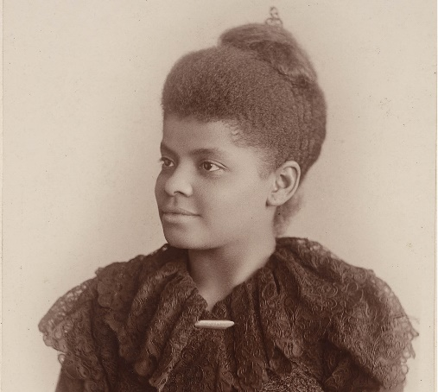
Constructing a narrative
Memphis had been left relatively unscathed by the Civil War, but not by its outcome. The 13th amendment brought an end to the Slave Trade that had been the economic and cultural foundation of the city. Without the slave markets selling men, women and children and the river boats and crews and suppliers and dock workers sending them up and down the river, Memphis was forced to declare bankruptcy in 1878. Seven months later, an intense yellow fever epidemic swept through the city killing many and forcing many others to evacuate and never return. The demographic of Memphis was dramatically altered and by the 1890s an increasingly black population accounted for around half of the population. This sparked an intense period of racism where African American communities were attacked by white mobs.
One woman who experienced this intense racism in Memphis was Ida D Wells. She was born a slave in 1882, received an education thanks to the Freedman’s Bureau and became a teacher before moving to Memphis. In 1884, she was travelling first class on a train to Nashville when the train crew ordered her to move to a carriage for black Americans. She protested and later sued the train company, but her case was overturned by the highest court in the state of Tennessee. Wells was so angry she became a journalist to raise attention to the unfairness of life for black Americans. Then in 1892, three of her friends were lynched (the murder of African Americans by white racists), Thomas Moss, Calvin McDowell, and Henry Stewart. These three men were owners of People's Grocery Company, and their small grocery had taken away customers from competing white businesses. A group of angry white men thought they would eliminate the competition so they attacked People's grocery, but the owners fought back, shooting one of the attackers. The owners of People's Grocery were arrested, but a lynch-mob broke into the jail, dragged them away from town, and brutally murdered all three. Ida wrote about the growing problem of lynching in the Freedom Post:
‘The city of Memphis has demonstrated that neither character nor standing avails the Negro if he dares to protect himself against the white man or become his rival. There is nothing we can do about the lynching now, as we are out-numbered and without arms. The white mob could help itself to ammunition without pay, but the order is rigidly enforced against the selling of guns to Negroes. There is therefore only one thing left to do; save our money and leave a town which will neither protect our lives and property, nor give us a fair trial in the courts, but takes us out and murders us in cold blood when accused by white persons.’
Think: What was Ida Wells advising African Americans in Memphis to do?

Slide 5
Her newspaper office was destroyed and the threats became so bad that Wells moved to Chicago where she continued to actively investigate and expose the fraudulent reasons given to lynch Black men, which by now had become a common occurrence across the South. Wells eventually became a founding member of the NAACP (National Association for the Advancement of Colored People) in 1909.
Shortly after Wells had been forced to flee Memphis, the wealthy white elite were raising money, $33,000 dollars, to build a statue to honour Forrest. This coincided with a widespread revival of Confederate statues throughout the South at the beginning of the 20th century to try and rewrite the history of the Civil War. Known as the Lost Cause, white southerners romanticised the war as about succession, not slavery, where confederate soldiers were heroic and saintly and African Americans were faithful slaves, loyal to the confederate cause and unprepared for freedom (Historian, Edward E. Baptist argues that the Unions decision in 1963 to welcome former slaves into its ranks ‘would make the difference between victory and defeat for the North’). Despite being a myth, the white supremacist narrative was widely accepted and reunited white Americans in their racism towards African Americans. This justified the South’s Jim Crow Laws to segregate public spaces and bar African Americans from voting, as well as lynching them into compliance. One newspaper in Memphis declared that the statue of Forrest “was not for the good it does the departed hero, but for the good it does for us and the good it will do for those who are to come after us.” The monument, white Memphians believed, “will stand for ages as the emblem of a standard of virtue.”
When the 20 foot statue was unveiled in 1905, 30,000 people crowded into the park and the adjacent streets to honour the northward facing general (he was originally going to face southwards, but it was felt that this made it look like he was retreating). In between a parade, music and poetry, a number of speakers spoke. They said nothing of him making his millions as a slave trader, nothing about how he had been the first Grand Wizard of the KKK, or of the terror, assassinations and the lynchings. Instead they spoke about how heroic and saintly he was and the proud heritage he had left behind.
Step 2: Constructing a narrative
1. What was the Lost Cause?
2. Do you think the Nathan Bedford Forrest Monument tells us more about Nathan Bedford Forrest or the crowd who came to celebrate its unveiling?

Slide 6
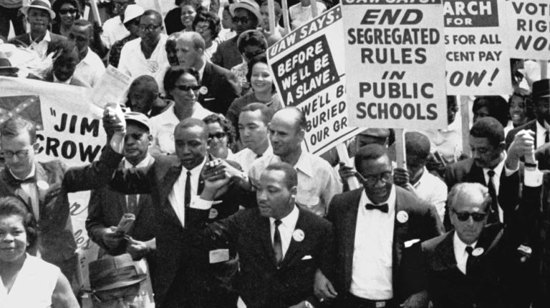
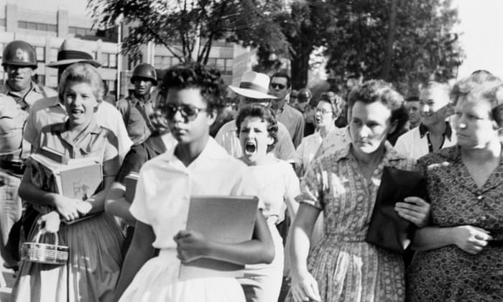
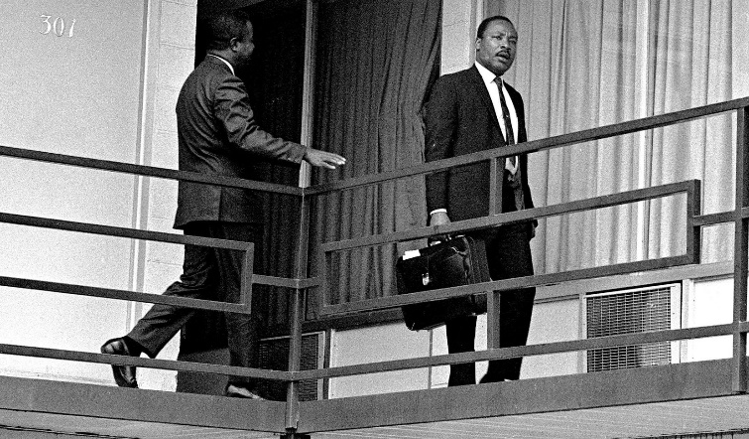
Debating the narrative
Throughout the Twentieth century, different Americans adopted Forrest as a symbol for their particular view of the past. For the first half of the century, the Jim Crow racial segregation laws in Southern states did not allow for African American feelings about the statue to be heard and the monument remained a constant reminder of the Lost Cause for many of the white population in Memphis.
However, numbers in Forrest park on the bank holiday to celebrate the general’s birthday were dwindling until the 1950s when segregation was under attack in the South. The NAACP were working hard to challenge segregation in public schools. The Brown v. Board of Education of Topeka, 1954, was a landmark Supreme Court case which ruled unanimously that racial segregation of children in public schools was unconstitutional. This became one of the cornerstones of the Civil Rights Movement, and helped establish the precedent that “separate-but-equal” education and other services were not, in fact, equal at all. Then, in 1957 a group of nine black students enrolled in an all-white High School in Little Rock. In response to desegregation in public schools, hundreds of white Memphians gathered in the park on his birthday in 1958 and Confederate flags were displayed.
Between 1961 and 1967, most Memphis schools integrated, however economic conditions worsened for African Americans. Despite the Civil Rights Act of 1964, white Memphians had elected a conservative mayor who supported segregation and opposed trade unions. In 1968, 1,100 African Americans sanitary workers went on strike after complaints of racial discrimination, low wages and the accidental death of two black workers. The white city government refused all of their demands and Martin Luther King came to Memphis to offer his support. On April 4, 1968, King was assassinated in Memphis. In the aftermath of his murder, the demographic of Memphis began to change and although the leaders continued to be white conservatives, the political influence of African Americans increased. As a result, the debate around the Forrest Monument began to focus on the fact that he was a prominent slave trader, the leader of the Fort Pillow massacre and first grand wizard of the KKK.

Slide 7
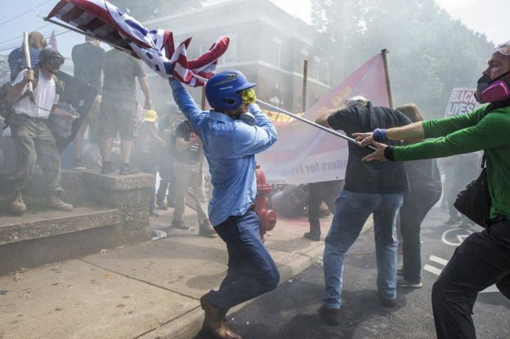
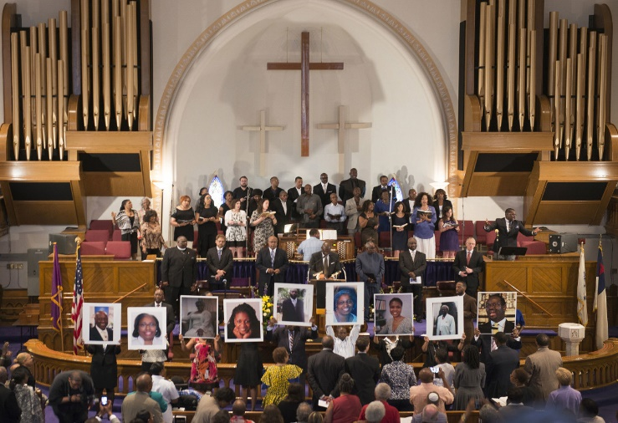
Despite this, it wasn’t until July 2015 when the Memphis city council unanimously voted to remove the statue. Earlier, in April, days after the 150th anniversary of the end of the Civil War, a white supremacist killed nine parishioners in an African-American church in South Carolina (below left). However, a law in Tennessee meant that the statue was protected as a war memorial, so the council had to sell off the park to a non profit company in order to remove the statues legally.
The statue was finally taken down in December 2017 before the 50th anniversary of Martin Luther King’s assassination in Memphis. A few months before a white nationalist protest in the city of Charlottesville had taken over the council's decision to remove a statue of the confederate’s most celebrated general, Robert E. Lee. The rally turned deadly when a counter-protester was killed and 19 injured by a far right extremist driving his car into them (below right).
Step 3: Debating the narrative
1. Memphis Mayor Jim Strickland said when the Forrest statue was removed that it "no longer represents who we are as a modern, diverse city with momentum.“
In what ways had Memphis become more diverse since 1905?
2. A group called Sons of Confederate Veterans tried to block the city's efforts to remove the statue by arguing that “the statue was part of America’s History”.
Who’s history is excluded from this interpretation of American history?
What is the danger of remembering one version of history over all others? (Can you find any consequences in the chapter?)

Slide 8
Rewriting the narrative
The shocking police brutality which caused the death of a black man, George Floyd in Minneapolis, Minnesota has led to the removal of Confederate statues across the South by anti-racist protesters in some cases and city leaders in others. However, when you find Minnesota on the map it complicates the location of the white supremacist narrative from our study of the Forrest Monument.
Think:
Find Minnesota on the map of the US
Why does its location complicate the narrative we have built so far?
Floyd’s death and the resulting Black Lives Matter protests across America shows us that racism wasn’t restricted to the South and historian Edward E. Baptist reminds us that after the Civil War and Reconstruction, ‘white Americans imposed increased white supremacy outside of the South too. In non-Confederate states, many restaurants wouldn’t serve black customers. Stores and factories refused to serve African American workers. Hundreds of Midwestern communities forcibly evicted African American residents. Most whites, meanwhile, believed that science proved that there were biologically distinct human races, and that Europeans were members of a superior one.’ In his book, ‘The half has never been told’, Baptist argues that America’s first professional historians, at the start of the twentieth century, were promoting across the US the same white supremacist narrative communicated by Forrest’s statue to hide the fact that America was built on and shaped by slavery.
Read the extract from ‘The half has never been told’. Highlight examples that Baptist uses to argue that the United States was built on and shaped by slavery.
Think: Why do you think the US hasn’t wanted to remember this half of the story in the birth of their nation?
‘In the span of a single lifetime after the 1780s, the South grew from the a narrow coastal strip of worn-out plantations to a subcontinental empire. Entrepreneurial slave traders moved more than 1 million enslaved people, by force, from the communities that survivors of the slave trade from Africa had built in the South and in the West to vast territories that were seized – also by force – from the Native Americans. From 1783 at the end of the American Revolution to 1861, the number of slaves in the US increased five times over, and all this expansion produced a powerful nation. For white enslavers were able to force enslaved African-American migrants to pick cotton faster and more efficiently than free people. Their practices rapidly transformed the southern states into the dominant force in the global cotton market, and cotton was the world’s most widely traded commodity at the time, as it was the key raw material during the first century of the industrial revolution. The returns from cotton monopoly powered the modernisation of the rest of American economy, and by the time of the Civil War, the US had become the second nation to undergo large-scale industrialisation. In fact, slavery’s expansion shaped every aspect of this new nation – not only increasing it’s power and size, but also, eventually, dividing US politics, differentiating regional identities and interests, and helping to make civil war possible.’

Slide 9
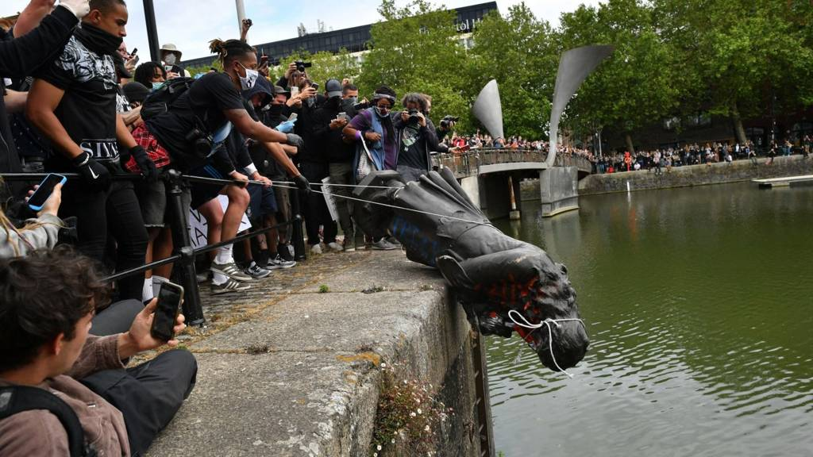
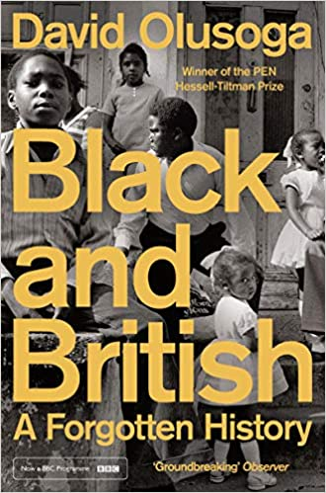
The Black Lives Matter protests have also raised a spotlight on how our own towns and cities are dotted with monuments from the 19th century, which airbrush the mainstream narrative of British history and expunge the history of black people. One of these, a statue of Edward Colston, was pulled down in Bristol by protestors and thrown into the river. Back in 1895, the white elite in Bristol decided that Colston should have a statue to remember his philanthropy (the money he donated to good causes in Bristol), but to forget that he earnt his fortune as a slave trader in the Royal African Company, where its estimated that during his period, 84,000 Africans were shipped as slaves to the Americas. Of that 84,000, about a quarter, 19,000, perished during the Middle Passage. Slave traders such as Colston called these deaths “wastage”. By forgetting Colston’s role in the British transatlantic slave trade, Bristol was able to also forget how much the city benefitted from it. Historian, David Olusoga, in his book, Black and British’ argues how British monuments to people like Colston are part of a wider amnesia in our national history. He explains that our understanding of the Industrial Revolution – a central part of national image - is incomplete without the often forgotten history that it was sourced by slavery – both British and American.
‘The Deep South in the 1860s represented one half of a global, transatlantic industrial economy. The Cotton Kingdom (Deep South in the US) was the economic twin of Manchester, or ‘Cottonopolis’ as it had come to be known…the city that clothed the world was supplied with the cotton that was her economic lifeblood by the city that is today her great rival but was then her closest ally – Liverpool…The roots of much of this wealth stretched across the ocean and into southern society, feeding off the lives and labour of 1.8million American slaves. Their bodies were commodities with the global cotton economy, their sweat and their suffering integral to Britain’s industrial power…Three decades after abolishing slavery and half a century after abolishing the slave trade Britain was, economically speaking, up to her neck in southern cotton slavery. Here the barriers between black British history and mainstream history break down. The Africans who grew and picked the cotton that landed in enormous bales on the docks of Liverpool, although they never set foot on British soil, are as much a part of our story as any black migrant. They were as much caught up in British power and the Atlantic economy as the West Indian slaves who just two decades earlier had been freed from slavery on British plantations.
Think:
How does Olusoga argue that African slaves in the southern cotton plantations in America are a key part of our national story?
Can we say that the Black Lives Matter is a protest against racism in America?

Slide 10
Step 4: Rewriting the narrative
Baptist’s story of the half never told draws on thousands of personal narratives from slaves where ‘each one adds to a more detailed picture of the whole’. You are going to read 3 of these personal narratives to explore what they reveal about different stages of the American slave trade, before adding them together to reflect on what they reveal about a slave’s journey from the auction block to the plantations.
What does Rachel’s story reveal about slave auctions?
What does Charles Ball’s story reveal about the new ‘pushing system’?
What does Joe Kilpatrick’s story reveal about building new lives?
4. What does adding their stories together reveal about a slave’s journey from the auction block to the plantations?

Slide 11
Enquiry outcome: Creating a new plaque
The Memphis city council have decided that the statue was not history, but the removing of the statue is. They would like a plaque to be placed at the spot where the Nathan Bedford Forrest statue once stood. You need to use your learning from across this enquiry to write the plaque explaining why the statue was taken down. You only have room for 250 words.
You may want to include include:
Who Nathan Bedford Forrest really was (Step 1)
Why the white elite in Memphis constructed a statue of him in 1905 (Step 2)
How Memphis has become more diverse since 1905 (Step 3)
The half never told – what slaves endured and how their suffering was central to the American and British industrial revolutions (Step 4)

